Slide 1
HP 2015 RZ2

Slide 2
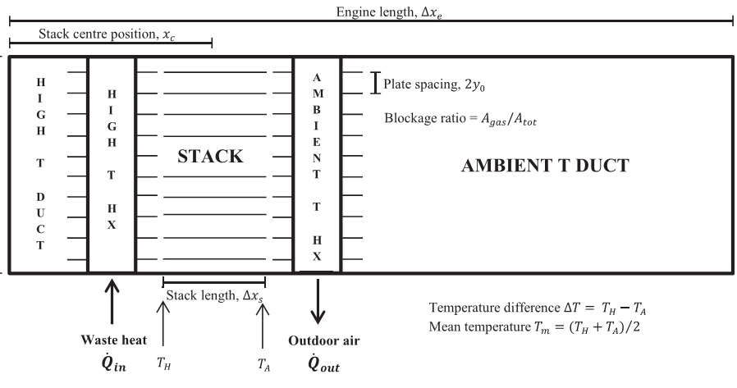
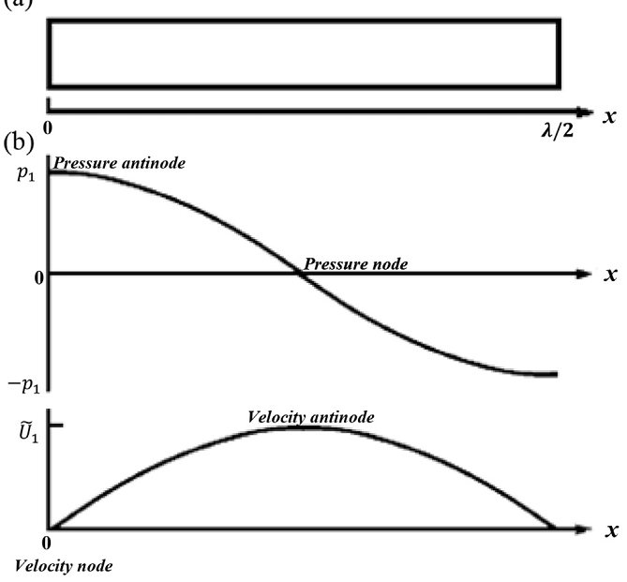
TAHE
Thermoacoustic heat engine

Slide 3
Enthalpy of flowing fluid
Energy lost by conduction
Axial Temperature gradient in stack

Slide 4
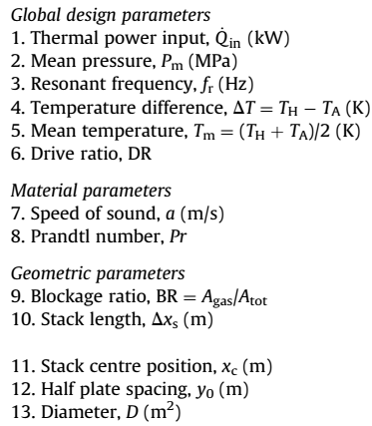
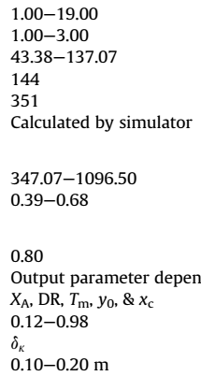
$$DR=\frac{p_{1}}{p_{m}}$$
Controlled by pressure
Controlled by composition He+Ne

Slide 5
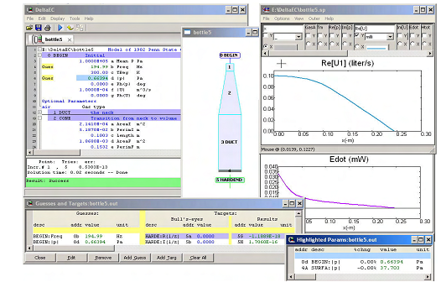
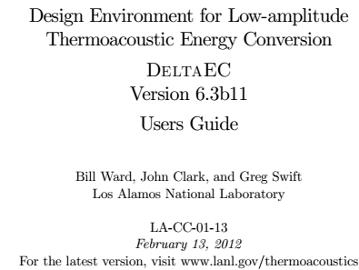
DeltaEC is used for optimization of parameters BR (Blockage ratio), DR (drive ratio), f (resonant frequency), p_{m} (mean pressure), loacation of stack X…
Maximum acoustic power (inner loop Global design params)
Minimum of acoustic losses (also material and geometry parameters)

Slide 6
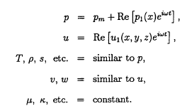
Theoretical background of DeltaEC was developed by Nikolaus Rott (Swiss Federal Institute of Technol., Zurich)
Puzzle: The following equations are Fourier Kirchhoff, continuity and Navier Stokes equation. Which is which?

Slide 7
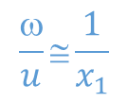
Critical gradient of stack temperature presented in lecture. Is it consistent with this inequality?
$$T_{m}−x_{1}\frac{dT_{m}}{dx}+\frac{2T_{m}βp_{1}}{ρc_{p}}>T_{m}+x_{1}\frac{dT_{m}}{dx}$$
$$\frac{ω}{u}≅\frac{1}{x_{1}}$$
$$\frac{T_{m}βp_{1}}{x_{1}ρc_{p}}>\frac{dT_{m}}{dx}$$

