Slide 1
HP 2015 RZ3
Adrian Bejan and EGM

Slide 2
HP 2015 RZ3

Slide 3
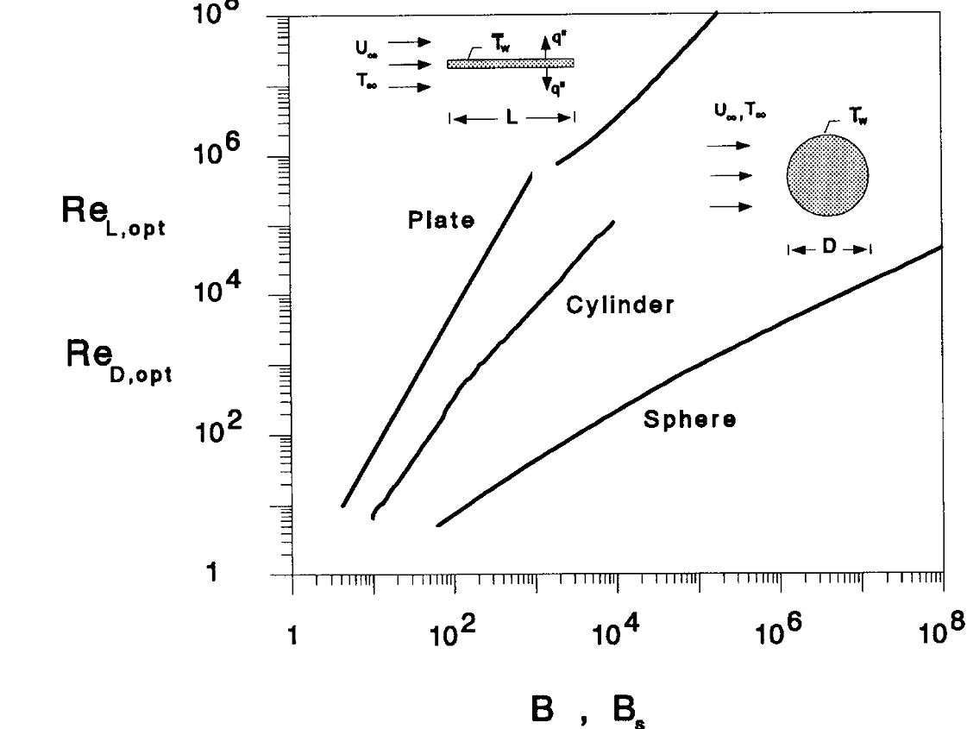
HP 2015 RZ3
Nusselt
Drag
Duty number
cylinder
sphere
plate

Slide 4
HP 2015 RZ3

Slide 5
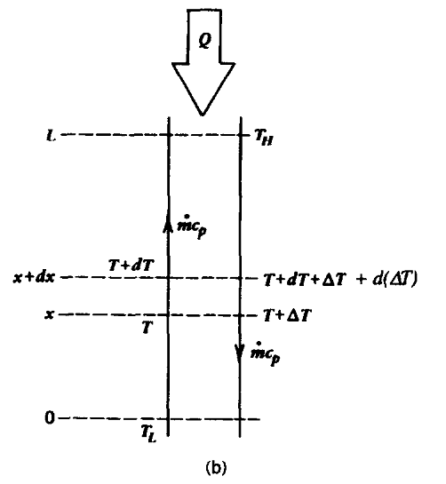
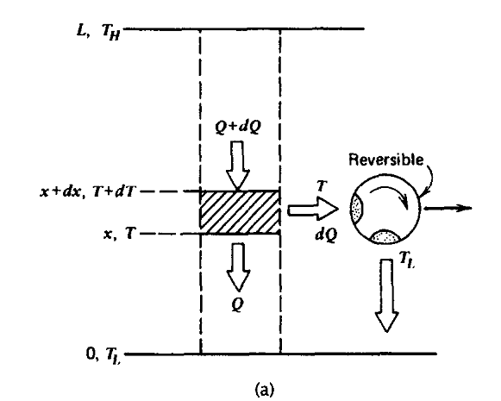
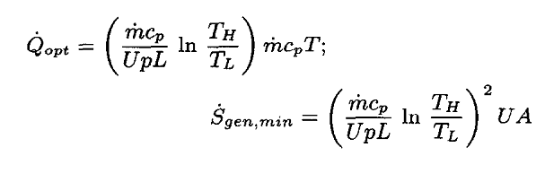
HP 2015 RZ3

Slide 6
HP 2015 RZ3
Fouling = cleaning time, defrosting…

Slide 7
HP 2015 RZ3

Slide 8
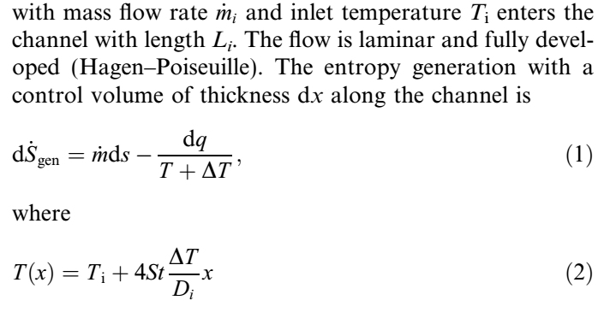
HP 2015 RZ3
integrating

Slide 9
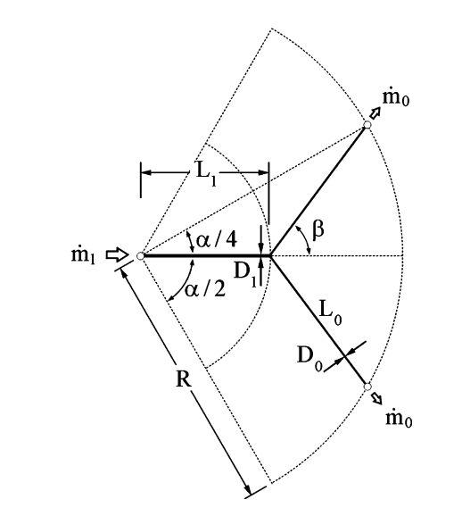
HP 2015 RZ3

